Slide 1
Data Centers Are a ‘Gold Rush’ for Construction Workers
Week 11 Ed Elowson

Slide 2
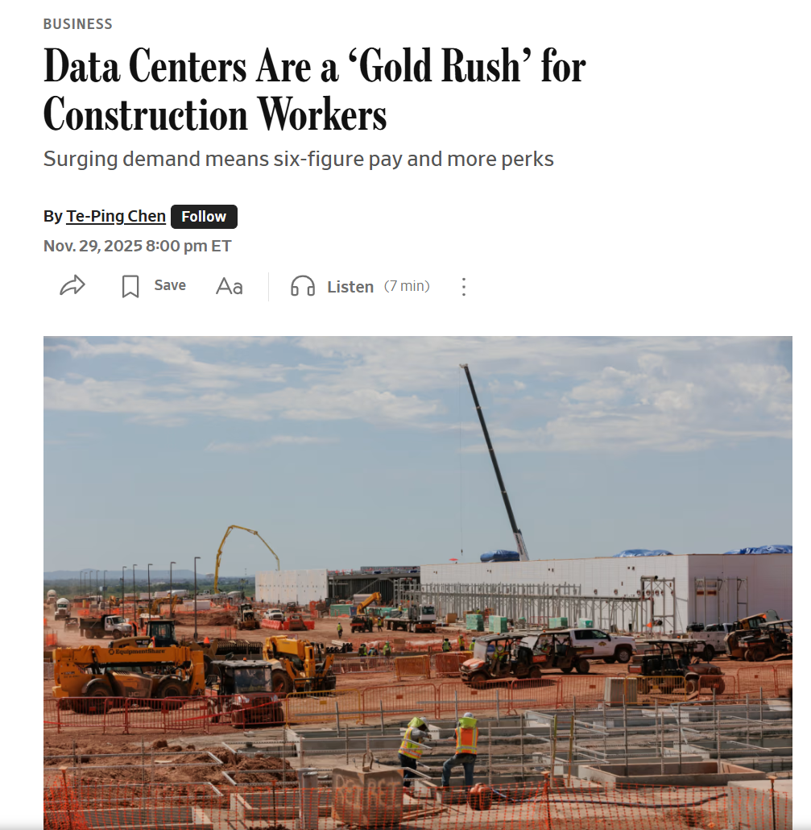
Screenshot

Slide 3
Link To The Source
https://www.wsj.com/business/data-centers-are-a-gold-rush-for-construction-workers-6e3c5ce0

Slide 4
Main Findings
The article argues that the rapid expansion of artificial intelligence is fueling an unprecedented boom in data-center construction, creating major opportunities for skilled construction workers. As companies like Amazon, Google, and Microsoft race to build AI infrastructure, demand for electricians, welders, project managers, and other trades has surged. Workers are seeing major salary increases, bonuses, improved benefits, and greater job stability.
A key finding is that AI is indirectly reshaping the labor market within construction. While AI is often associated with automation replacing jobs, this article shows that AI can also generate entirely new categories of work. The complexity and scale of data-center projects require thousands of skilled workers, and companies are struggling to fill positions because of existing labor shortages in the trades.
The article also highlights how competition among contractors has intensified. Companies are offering perks such as incentive pay, paid time off, air-conditioned break tents, remote management positions, and flexible travel arrangements to attract and retain talent. Construction firms increasingly describe the AI infrastructure market as a “gold rush” because of the large volume of available work and the high wages attached to it.

Slide 5
Broader Implications for Society
2. Broader Implications for Society
The article suggests that AI’s societal impact extends far beyond software and office jobs. The growth of AI infrastructure is reshaping regional economies, labor markets, and workforce development. Skilled trade workers who historically faced inconsistent employment are now experiencing greater financial security and long-term career opportunities.
Another broader implication is the renewed importance of vocational and technical education. As demand for electricians, pipefitters, and other skilled labor rises, apprenticeship programs and unions are expanding membership rapidly. This could shift societal perceptions about trade careers, making them more attractive alternatives to traditional four-year college pathways.
The article also raises questions about sustainability and infrastructure demands. AI systems require enormous amounts of computing power, which in turn drives massive investments in energy-intensive data centers. This creates long-term societal concerns involving electricity consumption, environmental impacts, land use, and resource allocation as AI adoption continues to grow globally.

Slide 6
Relevance or Potential Influence on the Construction Industry
The article demonstrates that AI is already transforming the construction industry indirectly through infrastructure demand. Data centers are becoming one of the fastest-growing sectors in construction, leading firms to prioritize specialized expertise in electrical systems, cooling systems, concrete work, and large-scale project coordination.
It also highlights a growing labor shortage challenge within construction. Because data-center projects pay significantly more than traditional construction work, labor may increasingly shift away from commercial, residential, or public infrastructure projects toward AI-related developments. This could increase costs and delays in other parts of the construction industry.
Finally, the article suggests that AI-driven construction demand may permanently reshape workforce expectations and business practices. Contractors are adopting new recruitment strategies, offering better benefits, and investing more heavily in worker retention. The industry may increasingly rely on technology-enabled coordination, remote project management, and highly specialized labor pipelines to meet the scale of future AI infrastructure projects.

Slide 7
